Slide 1


Road Repair Scheduling Using Priority Queue
Efficiently managing road repairs is crucial for maintaining safe and smooth transportation infrastructure. By utilizing a priority queue, local governments can prioritize critical issues and optimize resource allocation to address the most pressing road repair needs.
by Shobha Panchal

Slide 2
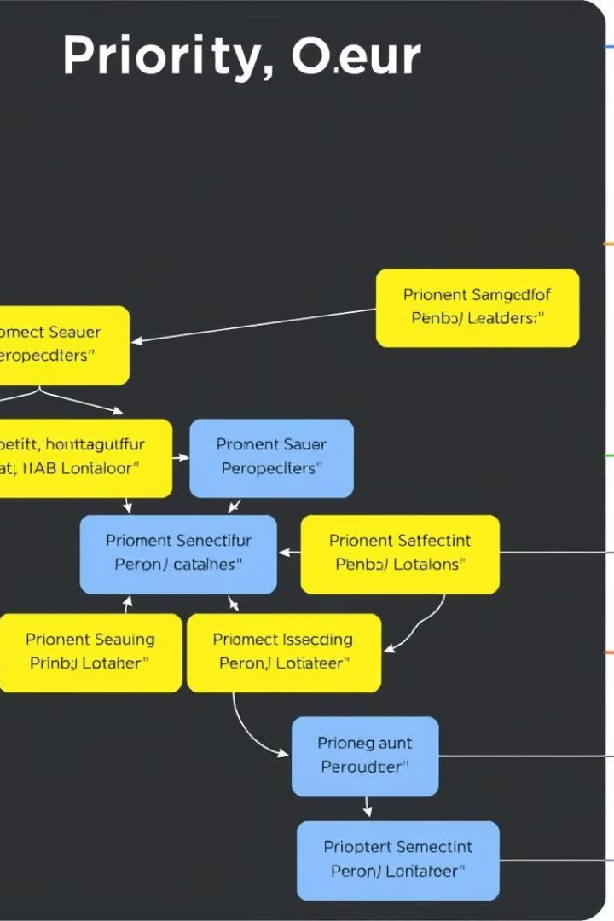
Introduction to Priority Queues
1
Dynamic Prioritization
2
Efficient Processing
A priority queue allows for the dynamic prioritization of tasks based on predefined criteria, such as severity of the issue or impact on the community.
Items in the queue are processed in order of their priority, ensuring the most critical repairs are addressed first.
3
Flexible Design
Priority queues can be implemented using various data structures, such as heaps or linked lists, allowing for customization based on specific needs.

Slide 3
Prioritizing Road Repair Requests
Severity
Impact
Urgency
Assess the severity of the road damage, considering factors like size of potholes, cracks, and the potential for accidents or vehicle damage.
Evaluate the impact of the road issue on the community, such as traffic volume, accessibility to key locations, and the overall disruption caused.
Determine the urgency of the repair based on factors like the rate of deterioration and the potential for the issue to worsen if left unaddressed.

Slide 4
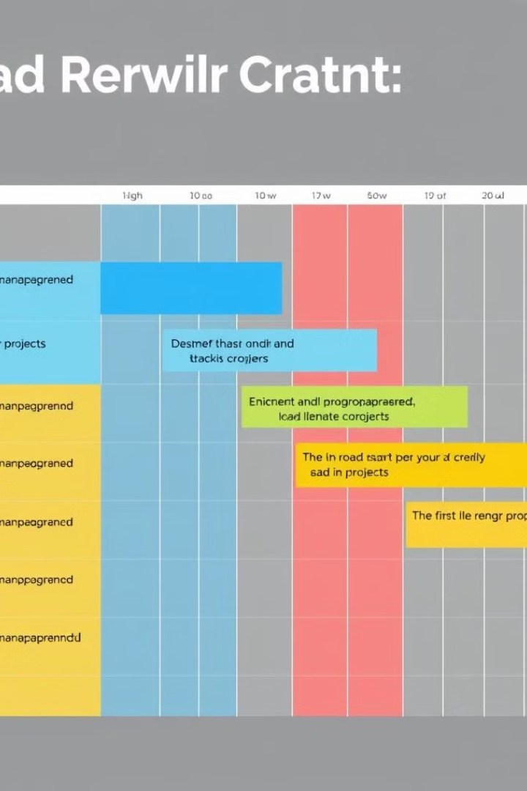
Algorithms for Scheduling Repairs
1
Assess Requests
Gather and analyze incoming road repair requests, evaluating each based on the prioritization criteria.
2
Schedule Repairs
Develop a repair schedule that optimizes resource allocation, minimizes disruption, and addresses the most critical issues first.
3
Monitor and Adjust
Continuously monitor the progress of repairs and be ready to adjust the schedule as new requests or unforeseen circumstances arise.

Slide 5
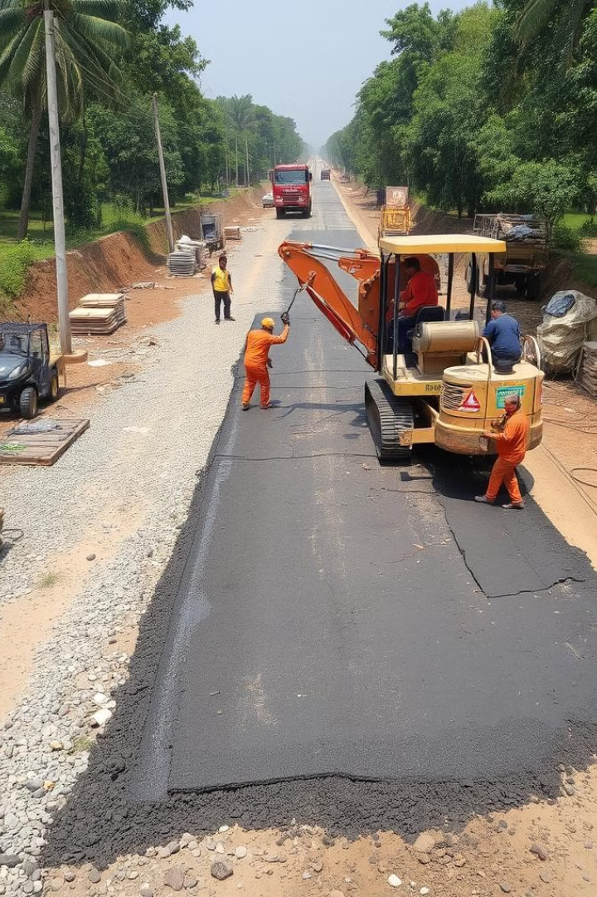
Optimizing Resource Allocation
Efficient Workflows
Resource Utilization
Streamline repair processes by scheduling work in a logical sequence and minimizing downtime between tasks.
Carefully manage the allocation of personnel, equipment, and materials to ensure optimal productivity and cost-effectiveness.
Data-Driven Insights
Collaboration
Leverage data analytics to identify patterns, predict future needs, and make informed decisions about resource deployment.
Foster cross-departmental cooperation to align priorities, share resources, and coordinate repair efforts for maximum impact.

Slide 6
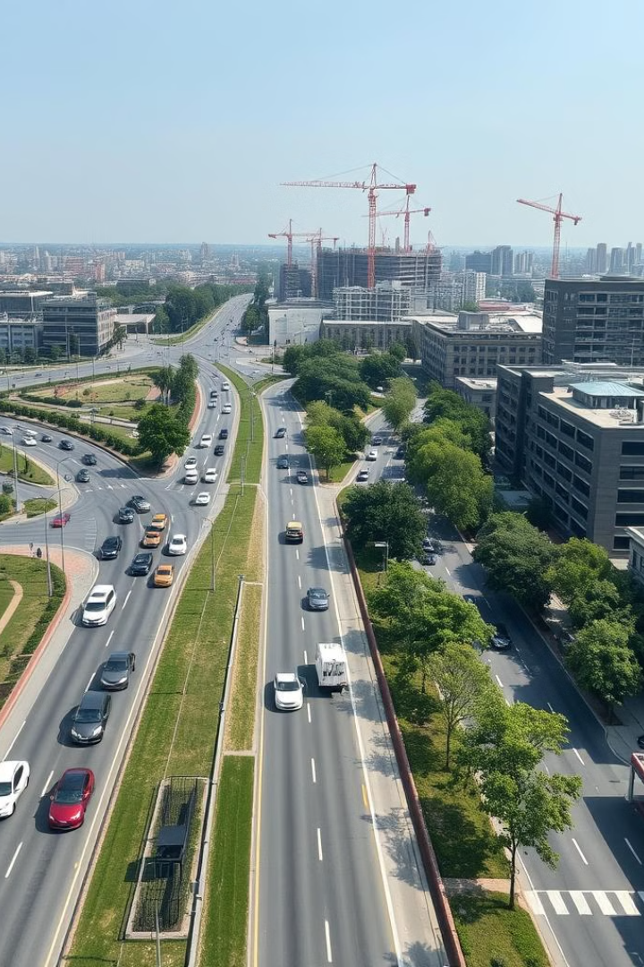
Conclusion and Next Steps
By embracing priority queue-based road repair scheduling, municipalities can significantly improve the efficiency, responsiveness, and overall impact of their infrastructure maintenance efforts. Continuing to refine algorithms, optimize resource utilization, and leverage data-driven insights will be crucial next steps in this journey.

